Slide 1
Equation Solver
Contributed by: Bilal Ahmed (21K-4864) and Ali Zain (21K-4653)

Slide 2
Introduction

Slide 3
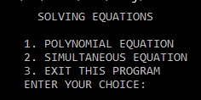
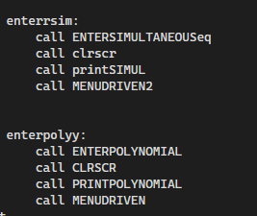
Introduction
Our program allows the user to input either a single polynomial equation of 2nd degree or a series of them for the user to solve them or use them as they see best.

Slide 4
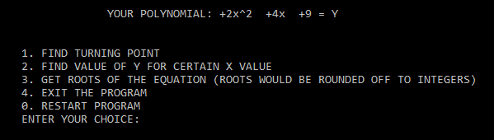
For a single equation, the user can either have it’s turning point, outputs for various ‘x’ inputs, or have its roots calculated, whether it be real or imaginary.

Slide 5
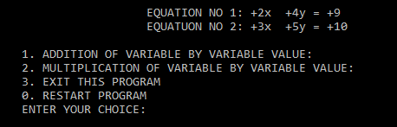
For a series of equations, the user can have product as well as sum of the equations.

Slide 6
Methodology

Slide 7
Methodology
The software is programmed using Assembly Language which runs using Microsoft Macro Assembler (MASM). The dependencies used are Irvine32 library for its built-in procedures and Macros. Visual Studio Community 2019 and later are utilized for working with the dependencies
Similar logics of high level languages were implemented in x86 language:
Turning Point: The equations is twice derivated in terms of ‘x’ to calculate the co-ordinates of turning point.
Calculating Y: The value of x is first inputted by the user and then substituted in the equation to determine the value of Y.
Determining Roots: The roots, whether they be real or imaginary, will be determined by equating the equation to zero.

Slide 8
Methodology
Addition of Equations: The equations are simultaneously added by storing the co-efficients of different variables in registers and adding them to form a single summated equation.
Multiplication of Equations: The equations are simultaneously multiplied by storing the co-efficients of different variables in registers and multiplying them to form a single equation which is a product of the series of equations.

Slide 9
Software Simulation

Slide 10
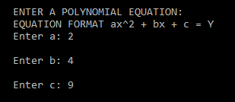
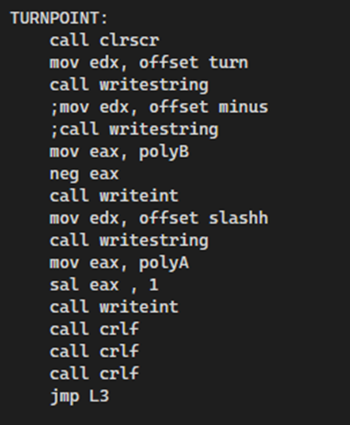

Software Simulation (Polynomial)
Inputs:
Turning Point:

Slide 11
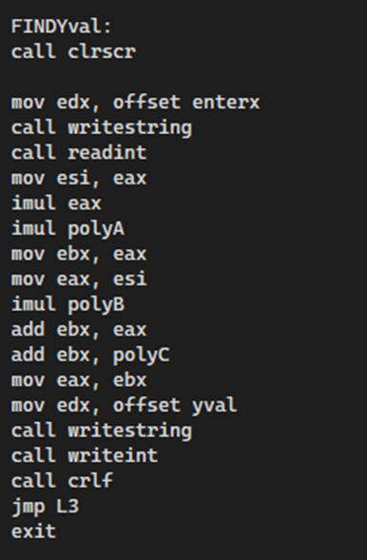


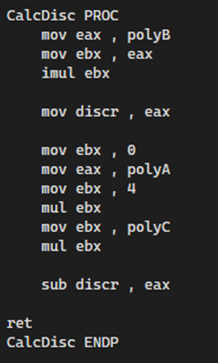
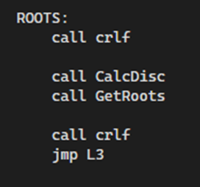
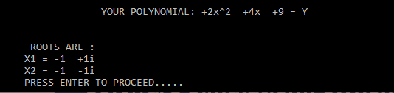
Software Simulation(Polynomial)
Calculating Y:
Inputting X:
Value of Y:
Determining Roots:

Slide 12
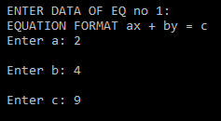
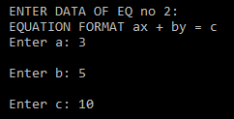
Software Simulation (Simultaneous)
Inputs:
1st Equation:
2nd Equation:

Slide 13
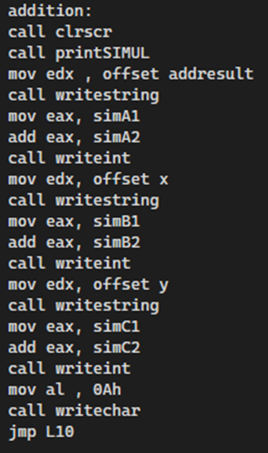

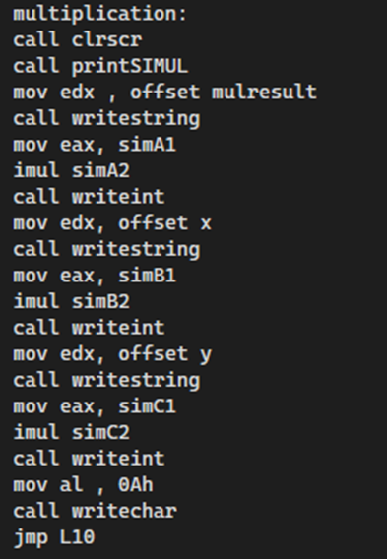

Software Simulation (Simultaneous)
Addition of Equations:
Multiplication of Equations:

Slide 14

Conclusion, Cost & Future Work
Despite the algorithms we used might be common and readily used, implementation of them in x86 language is not very common in the most user-friendly format. We would like to implement more functions in this projects and try to replicate the working of an actual scientific calculator. We will try to implement a user-friendly GUI to the project as well as launch our project code in various platforms for different enthusiastic users.

